Slide 1
Hands-On
Two kinds of measurements:
Automated measurements (Pushkal Agarwal)
Human-centered measurements (Xuehui “Rachel” Hu)
ACM WebSci 2021, Virtual Venue

Slide 2



Automated measurements
Human-centered measurements
Passive Data Collection
Using selenium automation visit websites
Logs websites traffic and HTML data
Needs no real user interaction
Scalable: Research studies have crawled near 1M websites
Active Data Collection
Browser extension based installation
To understand specific activities/ environments by logging data in real time by real users
To enhance the control in browsing behaviors

Slide 3
Automated Measurements Using OpenWPM Tool
Pushkal Agarwal
King’s College London

Slide 4
In this session: Setup and website data crawling
How to install / launch OpenWPM
What options / settings available
What crawling mechanisms are deployed
How to build synthetic profiles (Stateful)
What data can be collected
Hands On!
Ref: Online tracking: A 1-million-site measurement and analysis, ACM CCS 2016.
Notes:
Use OpenWPM go to some website and crawl. Give “taste” of what it feels like.

Slide 5
What is OpenWPM
(Open-source web privacy measurement tool)
Privacy measurements framework
Selenium
Python
Firefox
Stateless(ful)
Scalable (Thousands to Millions websites)
Easy to set-up!
Openly available at: https://github.com/mozilla/OpenWPM

Slide 6
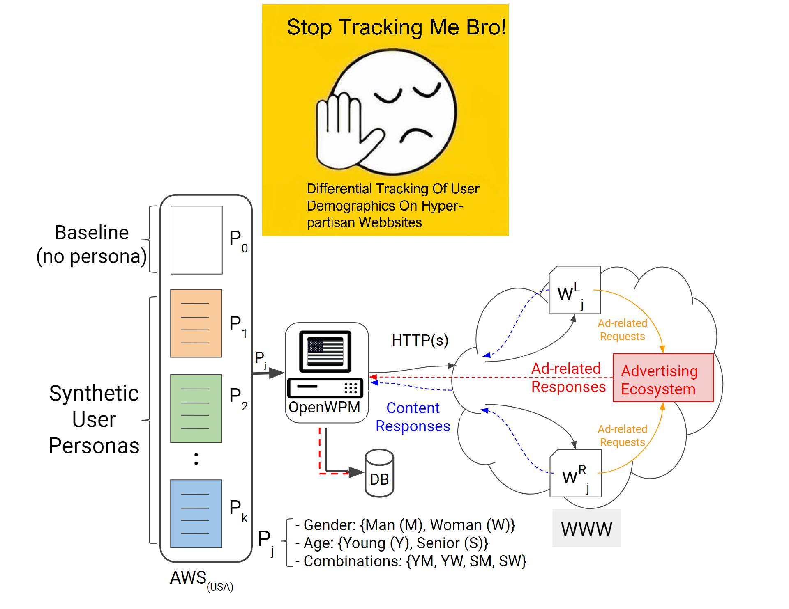

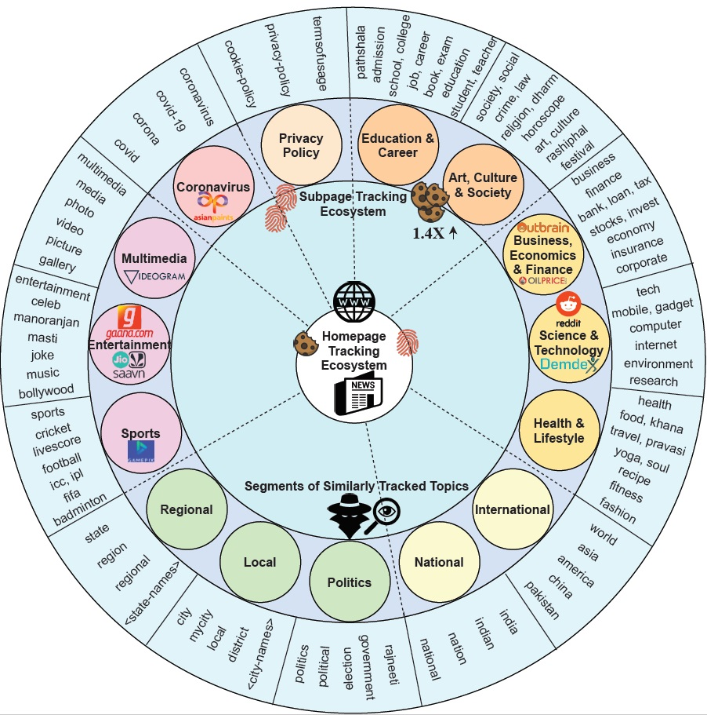
ACM Web-Science 2021
http://tiny.cc/india-topic
The Web Conference 2020
http://tiny.cc/partisan-tracking
AAAI ICWSM 2021
http://tiny.cc/india-tracking

Slide 7
Setup: As available on Github
Steps available on: http://tiny.cc/openwpm-install
Install using Anaconda (In house environment)
[Optional] Docker (container for running across platforms using local paths) Container: http://tiny.cc/openwpm-docker
Google Collab (Python notebook): http://tiny.cc/openwpm-colab
Ref: https://github.com/mozilla/OpenWPM

Slide 8
Setup: As available on Github
Steps available on: http://tiny.cc/openwpm-install
Install using Anaconda (In house environment)
[Optional] Docker Container: http://tiny.cc/openwpm-docker
Google Collab (Python notebook): http://tiny.cc/openwpm-colab
See you in the OPENWPM playground!
NOTE: Feel free to run Google Collab directly, if you don’t want to try the OpenWPM installation now.

Slide 9
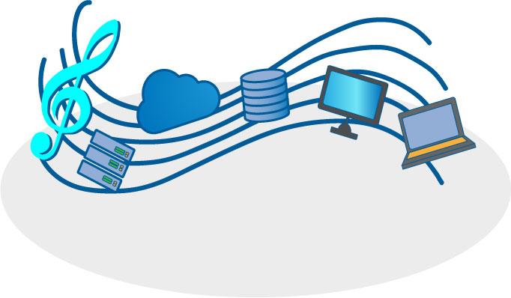
What options / settings available?
Parallel orchestration
Plug-ins for ad-blocking
Headless browsing
Snapshots
Scroll pages
Stateful (less)
Much more!
$vim demo.py

Slide 10
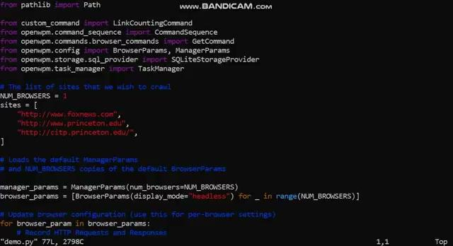
Options in /openWPM/demo.py

Slide 11
What crawling mechanisms are deployed?
Crawling website traffic.
First-party cookies.
Third-party cookies
Canvas fingerprinting, evercookies and cookie syncing.
AAAI ICWSM, Under the Spotlight: Web Tracking in Indian Partisan News Websites (2021) tiny.cc/india-tracking/
The Web Conference (WWW), Stop tracking me Bro! Differential Tracking of User Demographics on Hyper-Partisan Websites (2020) http://tiny.cc/partisan-tracking

Slide 12
In this tutorial activity
Case study 1: Tracking across countries
USA versus India news websites (Stateless)
Case study 2: Building artificial user personas
Women versus Men (Stateful, “default”)
$vim demo.py → <change websites names>

Slide 13

Case study 1: Changing websites list
http://www.foxnews.com
http://ndtv.com
…

Slide 14
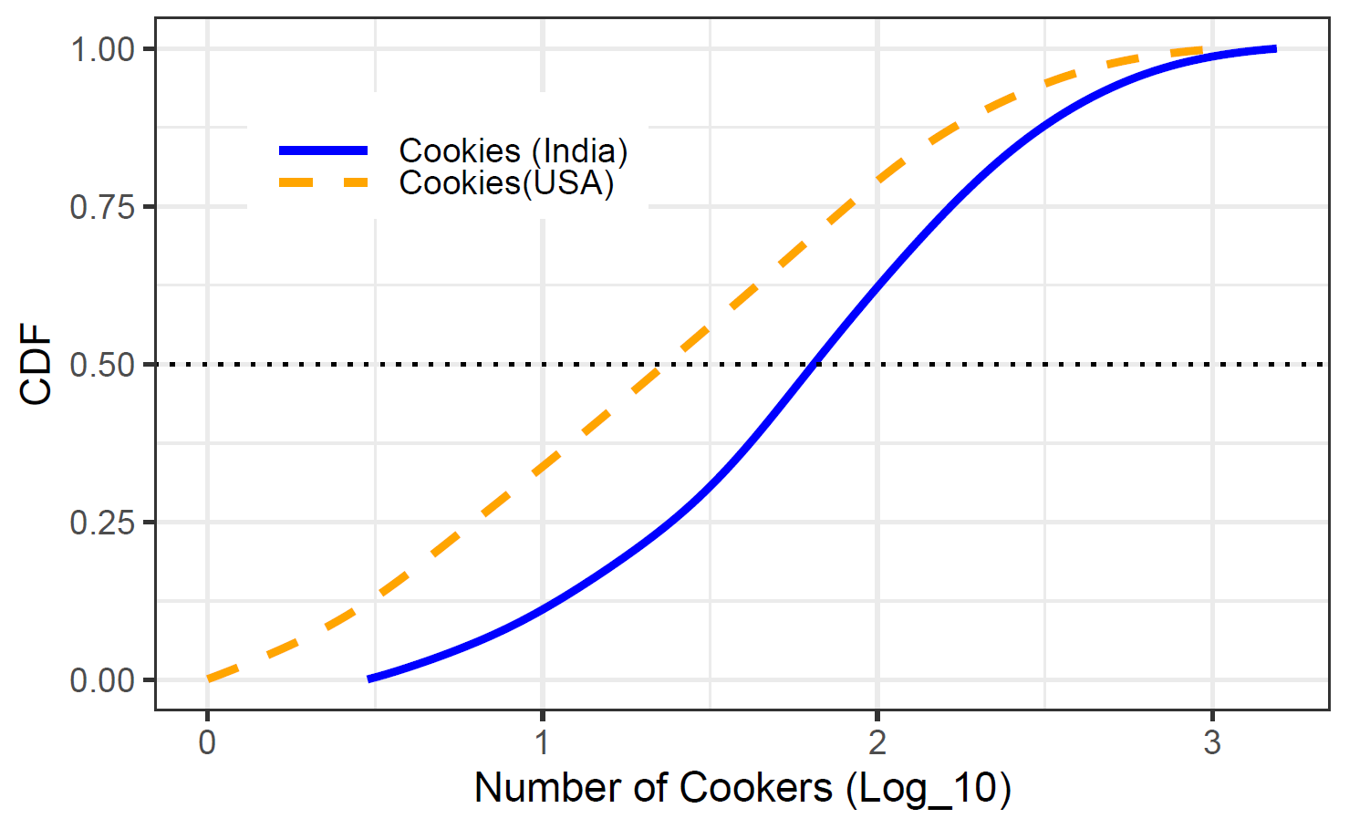
Results from case study 1
Cookies counts per website as an indicative of tracking
Median Tracking in India is “three” times then tracking in USA news.
Some websites can track by having 1000+ cookies
Agarwal et. al, ICWSM 2021

Slide 15
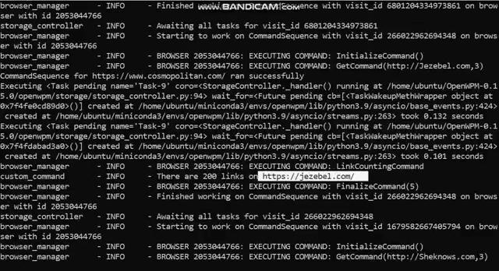
Case 2: Building user Personas
https://www.cosmopolitan.com/ ,
http://Jezebel.com ,
http://Sheknows.com
...

Slide 16
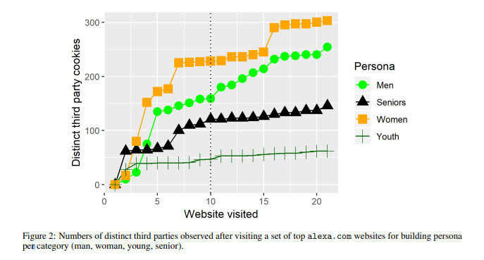
Results from case study 2
People have browsing behaviour.
Can exhibit certain characteristics:
Political affiliation
Demographics
Stateful Crawls with 20 websites
After visiting certain websites...
Exported as Profile.tar
Loaded on other crawls
Agarwal et. al, WWW 2020

Slide 17
What data should be collected?
Traffic logs
Cookies information
Javascripts
HTTPs logs
Meta: Visit sequence and settings
Profile.tar file (if stateful crawl)
Snapshots (if needed)
Agarwal et. al, WWW 2020

Slide 18
Hand On!
Analysis: So let’s try…
http://tiny.cc/openwpm-colab
OR https://colab.research.google.com/drive/17XxF4RPOkhpyJqvWGe2c0HBf10uZIIhE

